Slide 1
SOTWARE TESTING (CS-497)
Course Instructor: AMIR IMAM

Slide 2
Testing throughout the Software Life Cycle
Software Development Model with respect to testing
Waterfall
V-Model (Validation Verification)
Agile (SCRUM/KANBAN)
Testing Levels (Unit/Integration/System/UAT)
Testing Types
Functional (Sub types)
Non Functional (Sub types)
Others
Bug Life cycle

Slide 3
Test Levels, Type and Approaches
Unit Test
Integration Test
System Test
User Acceptance (UAT)
Functional Testing
Non-Functional Testing
Smoke Testing
Regression Testing
Re-Testing
Performance Testing
White-BOX Testing
Security Testing
Sanity Testing
Alpha Testing
Beta Testing
Factor Acceptance Test (FAT)
Site Acceptance Test (SAT)
Usability Testing
Stress Testing
Load Testing
Compatibility Testing
Black-BOX Testing

Slide 4
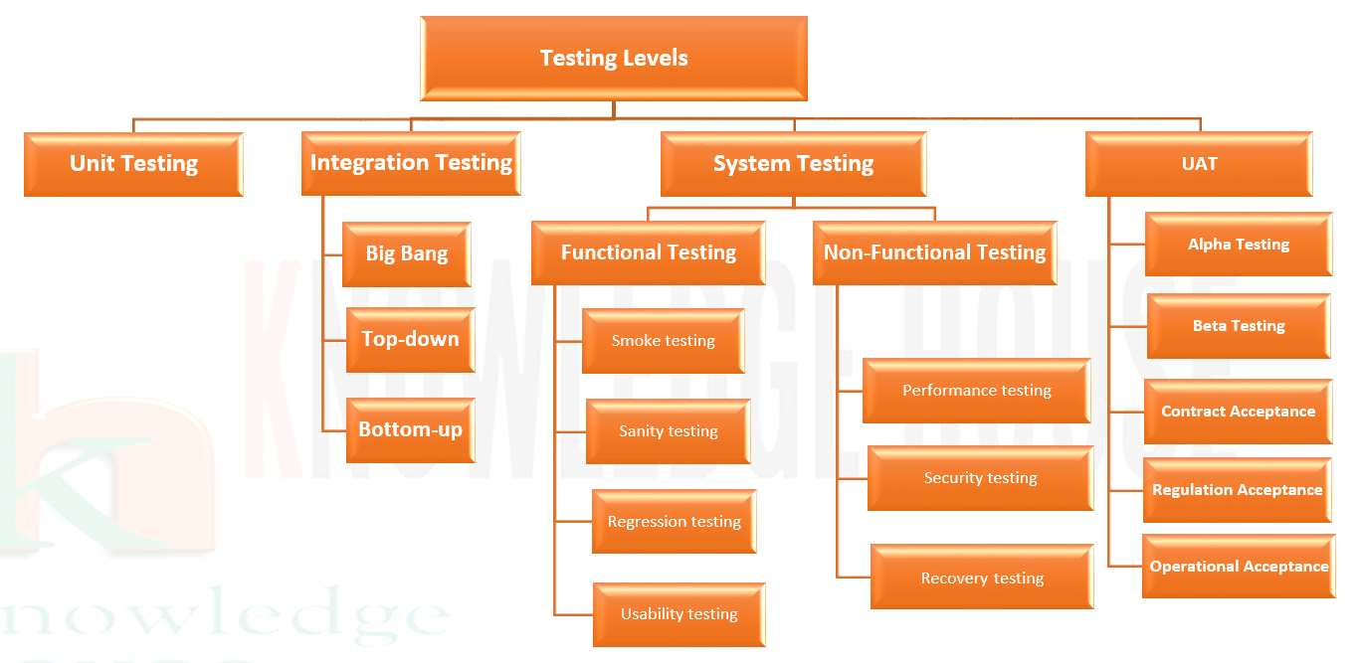
Test Levels, Type and Approaches

Slide 5
Verification
Verification makes sure that the product is designed to deliver all functionality to the customer.
Verification is done at the starting of the development process.
It includes reviews and meetings, walk-throughs, inspection, etc. to evaluate documents, plans, code, requirements and specifications.
It answers the question like: Am I building the right product?

Slide 6
Validation
Validation is determining if the system complies with the requirements and performs functions for which it is intended and meets the organization’s goals and user needs
It is done at the end of the development process and takes place after verifications.
It answers the question like: Am I building the right product?

Slide 7
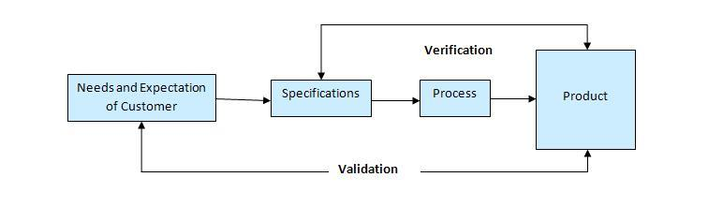
Verification & Validation

Slide 8
Software Development Model
There are various Software development models or methodologies. They are as follows:
Waterfall model
V model
Incremental model
Sequential
Iterative model
RAD model
Agile model
Spiral model
Prototype model

Slide 9
Software Development Models
Choosing right model for developing of the software product or application is very important.
Based on the model the development and testing processes are carried out.
These days in market the ‘Agile Methodology‘ is the most used model.
‘Waterfall Model‘ is now considered to be the very old model.
‘V-model‘ is also used by many of the companies in their product. ‘V-model’ is nothing but ‘Verification’ and ‘Validation’ model.
Likewise ‘Incremental model’, ‘RAD model’, ‘Iterative model’ and ‘Spiral model’ are also used based on the requirement of the customer and need of the product.

Slide 10
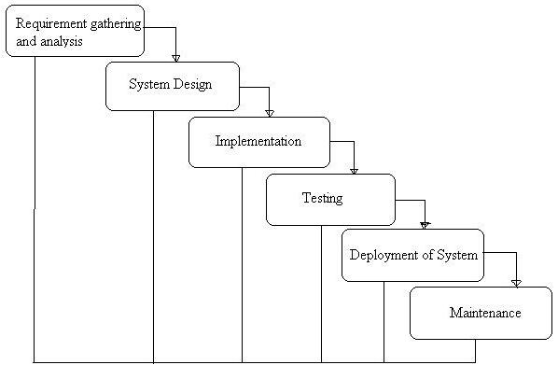
Waterfall Model
The Waterfall Model was first Model to be introduced.
At the end of each phase, a review takes place to determine if the project is on the right path and whether or not to continue or discard the project.
In this model Software Testing starts only after the development is complete.
In waterfall model phases do not overlap.
Cost of fixing issues are high.

Slide 11
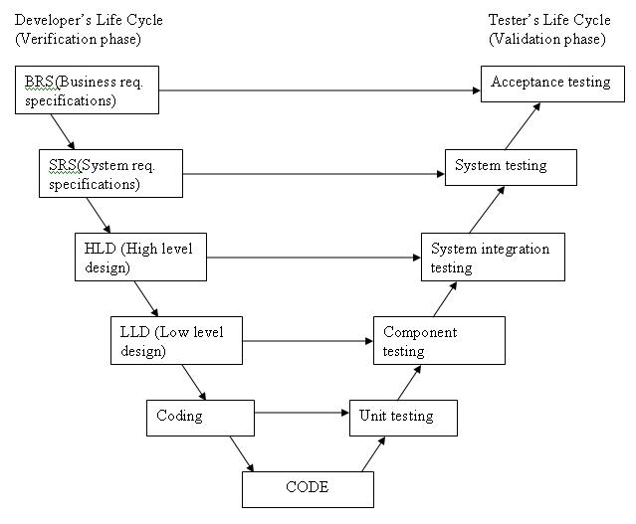
V-Model
A Sequential Model
Testing of the product is planned in parallel with a corresponding phase development phase.

Slide 12
V-Model
Requirements like BRS and SRS begin the life cycle model just like the waterfall model.
Before development is started, a System Test plan is created.
The Test Plan focuses on meeting the functionality specified in the requirements gathering.

Slide 13
V-Model
The high-level design (HLD) phase focuses on system architecture and design.
It provide overview of solution, platform, system, product and service/process.
An Integration Test plan is created in this phase as well in order to test the pieces of the software systems ability to work together.

Slide 14
V-Model
The low-level design (LLD) phase is where the actual software components are designed.
It defines the actual logic for each and every component of the system.
Class diagram with all the methods and relation between classes comes under LLD.
Component Tests are created in this phase as well.

Slide 15
V-Model
The implementation phase is, again, where all coding takes place.
Once coding is complete, the path of execution continues up the right side of the V where the test plans developed earlier are now put to use.
Module design is converted into code by developers. Unit Testing is performed by the developers on the code written by them.

Slide 16
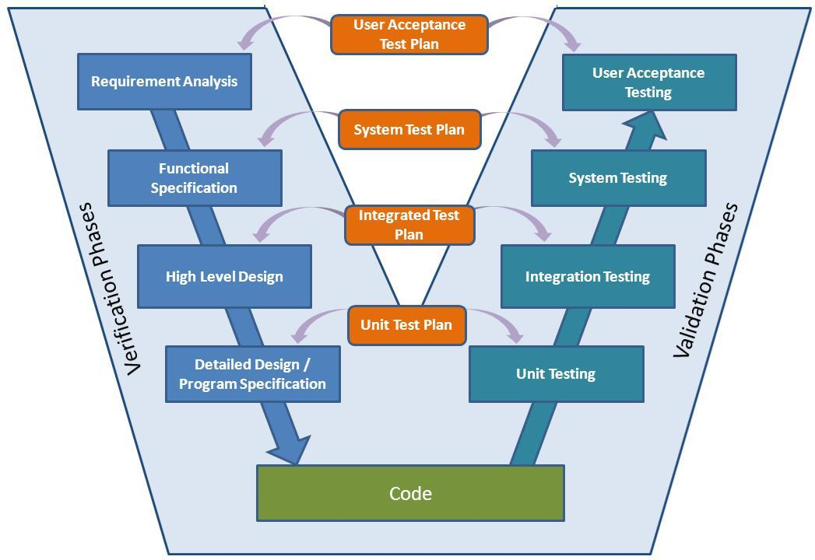

Slide 17
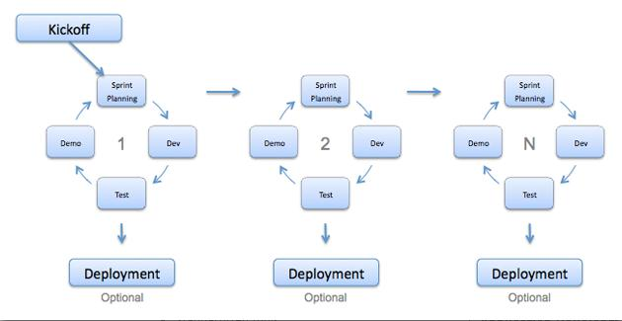
Agile Development Model
Agile development model is an Iterative Incremental model.
This results in small incremental releases with each release building on previous functionality.
Each release is thoroughly tested to ensure software quality is maintained.
It is used for time critical applications.
SCRUM and Extreme Programming (XP) is currently one of the most well known agile development life cycle model.

Slide 18
Agile Development Model

Slide 19
Advantages of Agile model
Customer satisfaction by rapid, continuous delivery of useful software.
People and interactions are emphasized rather than process and tools.
Customers, developers and testers constantly interact with each other.
Working software is delivered frequently (weeks rather than months).
Face-to-face conversation is the best form of communication.
Close, daily cooperation between business people and developers.
Continuous attention to technical excellence and good design.
Regular adaptation to changing circumstances.
Even late changes in requirements are welcomed.

Slide 20
Disadvantages of Agile model
In case of some software deliverables, especially the large ones, it is difficult to assess the effort required at the beginning of the software development life cycle.
There is lack of emphasis on necessary designing and documentation.
The project can easily get taken off track if the customer representative is not clear what final outcome that they want.
Only senior programmers are capable of taking the kind of decisions required during the development process. Hence it has no place for newbie programmers, unless combined with experienced resources.

Slide 21
Using Agile Model
When new changes are needed to be implemented (implemented in very little cost).
To implement a new feature the developers need to lose only the work of a few days, or even only hours, to roll back and implement it.
Unlike the waterfall model in agile model very limited planning is required to get started with the project.
Agile assumes that the end users’ needs are ever changing in a dynamic business and IT world.
Changes can be discussed and features can be newly effected or removed based on feedback.
This effectively gives the customer the finished system they want or need.

Slide 22
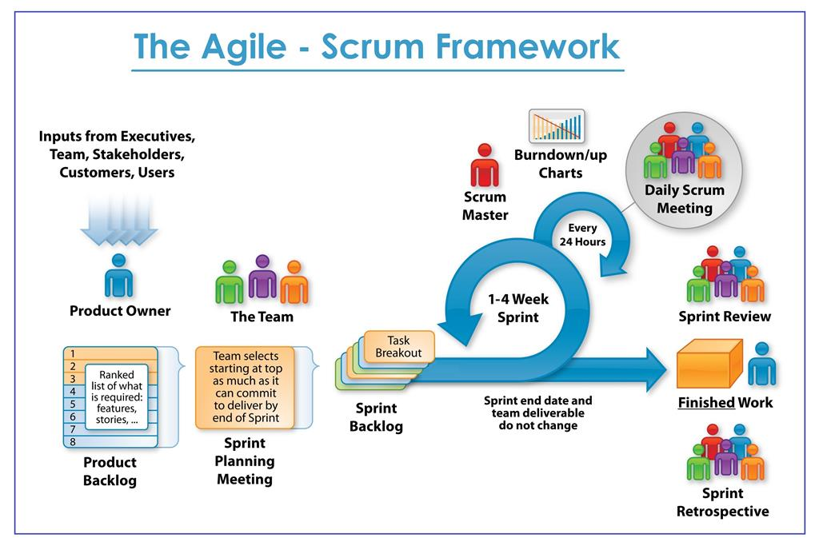

Slide 23
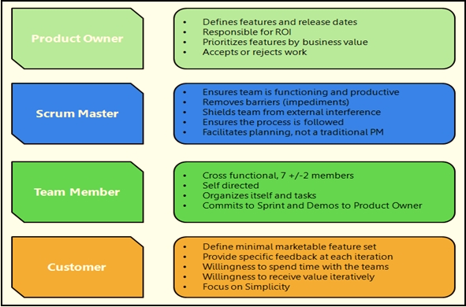

Slide 24
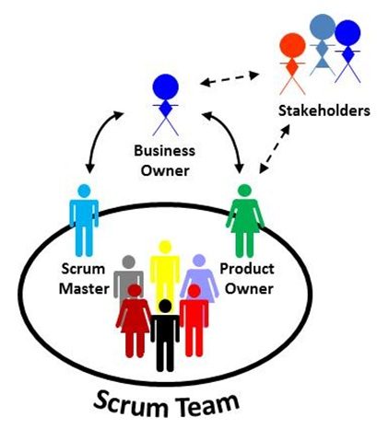
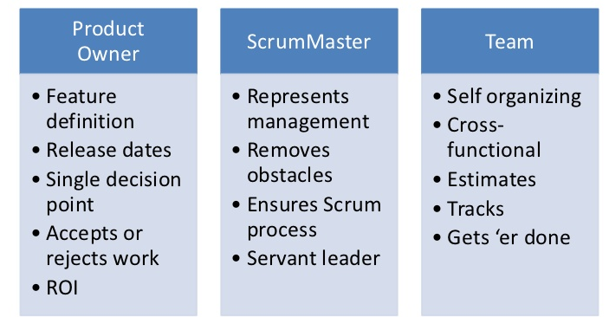
Agile SCRUM Team and Roles

Slide 25
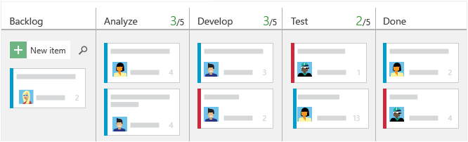
KANBAN

Slide 26
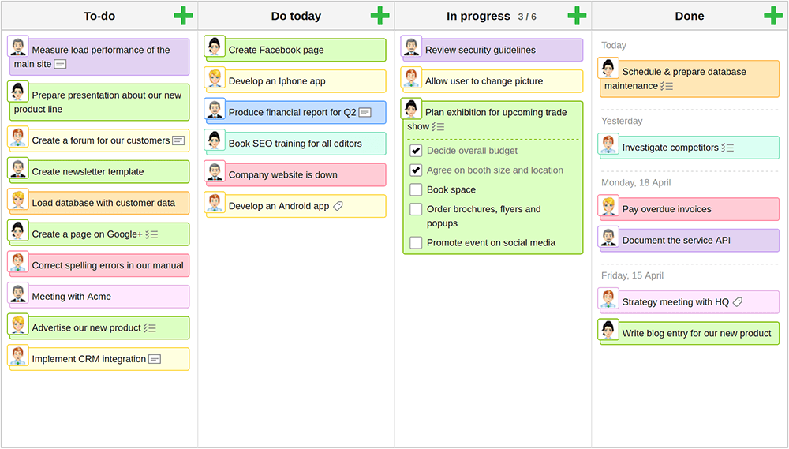

Slide 27
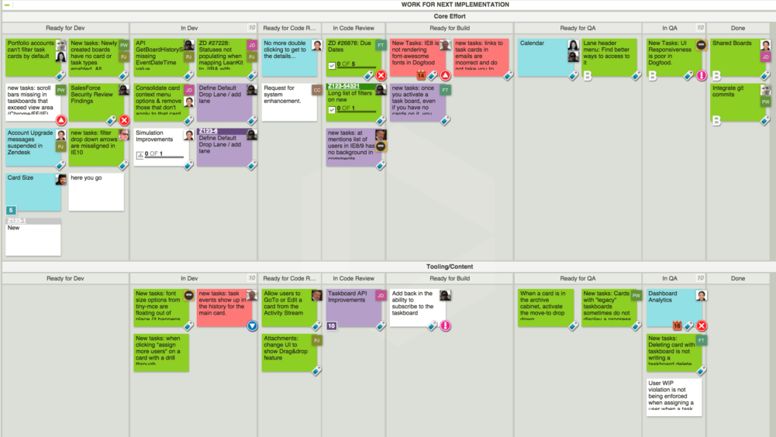

Slide 28
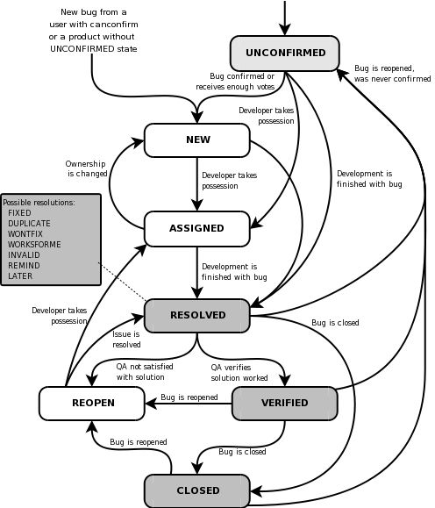
Bug Life Cycle
Good bug reports contains:
Descriptive Title
Concise Description
Expected Results
Details About The Project And Version
Platform Details
Defect Type And Severity
Steps To Reproduce Visual Attachment
Tags & Links
Assignee

Slide 29
END!

